Slide 1
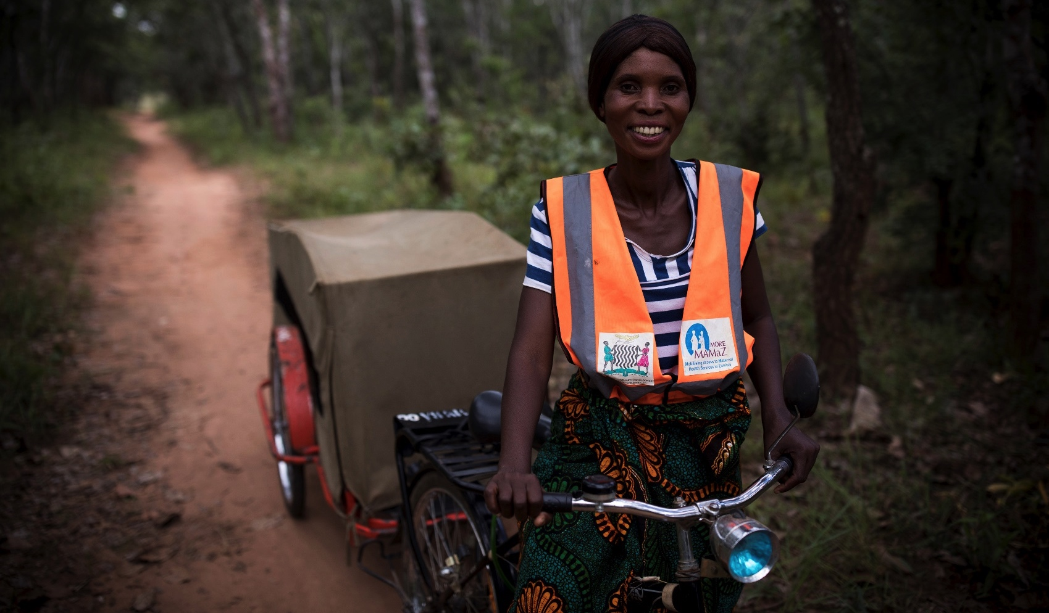


MAMaZ Against Malaria, Zambia
Lessons Learned and Policy Implications

Slide 2
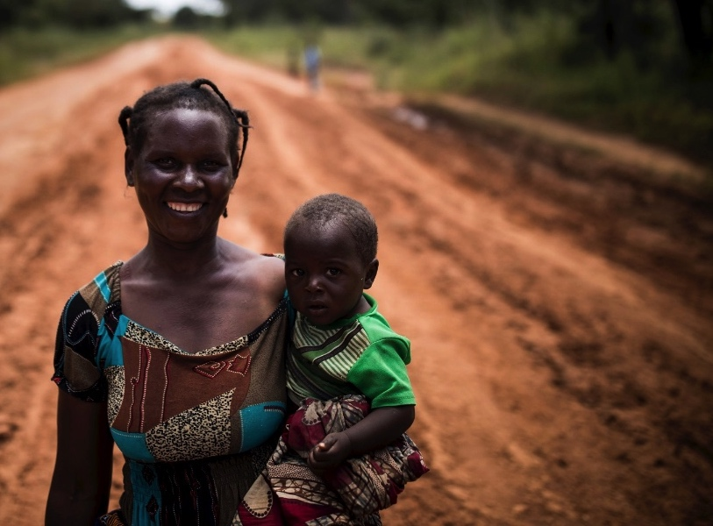
Caroline Barber,
Chief Executive,
Transaid
Tendayi Kureya,
Executive Director, Development Data

Slide 3
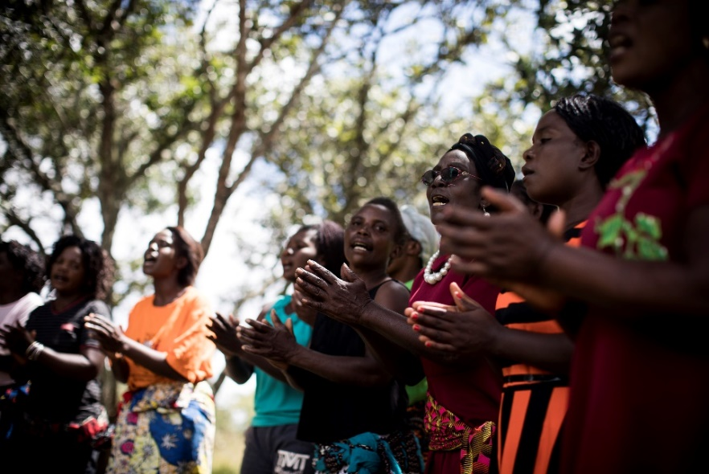
Lessons Learned
MAM built on a foundation of large numbers of highly motivated and well-trained SMAG volunteers – proved very effective at managing SM cases.
MAM trained up to 14 CHVs per intervention site - increased coverage and created a network of volunteers to support each other
This helped with motivation, sustainability and reaching the least supported
‘Whole community’ approaches are
needed to change social norms in favour
of improved child health care seeking.
Notes:
Notes
SMAGs = safe motherhood action group volunteers
i-CCM = Integrated Community Case Management of Malaria

Slide 4
Lessons Learned
Average distance to the HF was 14 kms - Community-based ETS can significantly reduce travel times to the HF
Increasing demand for SM services is only fully effective when case management is improved and available
  A reliable supply of drugs and consumables, and well-trained health providers encouraged use of severe malaria services.
  The team worked in partnership with DHMT and NMEC and were able to respond to challenges and troubleshoot.
  Case Study
  The opening hours at one Rural Health Post proved problematic for communities. The facility closed at 16.00 hrs. This meant that some patients needing a second or third dose of Injectable AS had to travel to the District Hospital, and this sometimes caused hardship. The DHMT responded quickly and is currently looking at ways it can extend the health facility’s opening hours in response to community feedback.

Slide 5
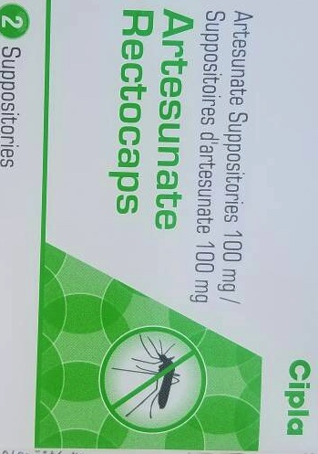
Key Messages for Policy Makers
Message 1
MAM provided proof of concept that RAS quality assured 100mg administered at community level is a highly effective intervention for severe malaria among young children (6 months to 6 years old). The SM case fatality rate in this age group fell by 94.6%. It is recommended that community RAS is scaled up across the country as part of Zambia's strategy for reducing SM mortality.
Message 2
RAS is not yet widely available in Zambia. It is recommended that development partners work with the MOH to expedite procurement of quality assured RAS through the national system so that the intervention can be scaled up to other rural districts in 2019. Once procured, it will be important to ensure timely quantification
and procurement of stock to prevent stock outs.

Slide 6

Key Messages for Policy Makers
Message 3
Effective case management of SM in young children requires access to RAS, Inj AS, and commodities such as RDTs and disposable gloves. An uninterrupted supply of these essential SM drugs and commodities will be essential as community RAS is scaled up in Zambia.
Message 4
  MAM demonstrated that different cadres of CHV can be successfully trained to administer RAS and mobilise communities around a child health agenda. Training a variety of CHVs (SMAGs, i-CCM, CHVs) builds on existing structures, increases coverage, promotes equity of access to SM services, helps sustain the CHVs’ work, and is cost- effective. It is recommended that the MOH follows this approach and incorporates good practice from MAM's RAS training approach into i-CCM and other CHV
  training manuals.

Slide 7
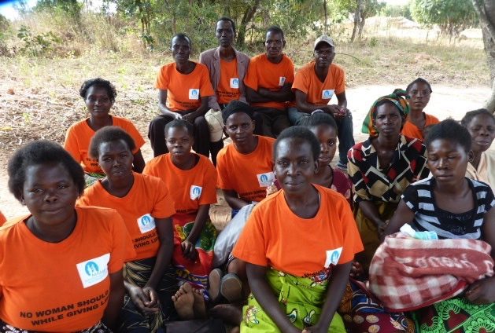
Key Messages for Policy Makers
Message 5
It is recommended that the MOH considers training adequate numbers of CHVs in each community (1 CHV: 250 population) to increase coverage. Training 1-2 CHVs per community in SM case management is unlikely to substantially increase communities' access to RAS and treatment. Distances within communities are large and the reach of individual CHVs is small.
Message 6
MAM trained CHVs to mobilise their communities in support of a SM agenda and to set up and manage community systems to address the access and affordability barriers to use of services. As community RAS is rolled out in Zambia, it will be important to ensure that CHVs receive adequate training on community mobilisation and supportive community systems, drawing on good practices from MAM including the use of innovative participatory training tools (e.g. communication body tools).
Notes:
Refer to fact that MAM CHVs worked 13hrs a week, iCCM vols 38 hrs per week….

Slide 8
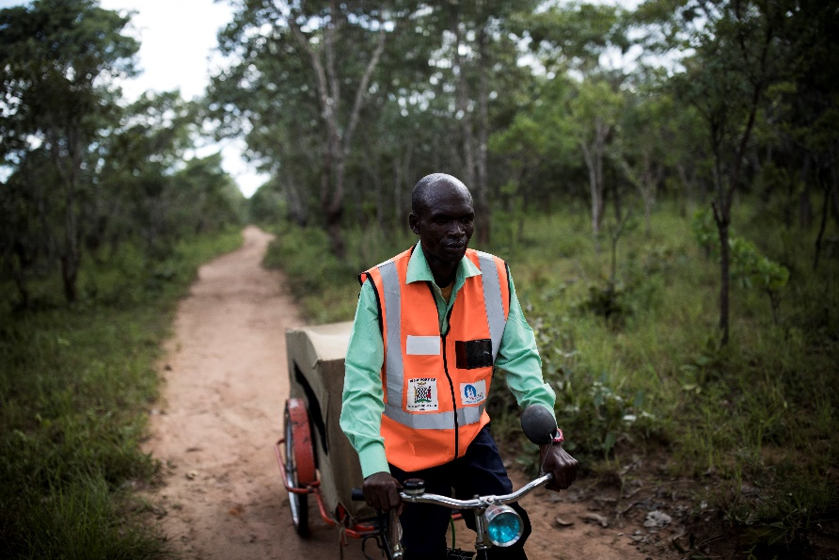
Key Messages for Policy Makers
Message 7
Whole community approaches are needed to change social norms in favour of improved child health care seeking. It is therefore crucial that CHVs are trained to promote male involvement in health. CHVs also need to be trained to promote social inclusion. Reaching the least-supported women in the community is
essential since
they and their
children usually
carry the highest
burden of ill-health.
Message 8
The link between communities and lower level HFs is often the weakest in the health referral chain. Community-managed ETS can significantly reduce travel times to the HF and be a positive factor in encouraging prompt referral of very sick children. The MOH and districts need to budget
for replacement
ETS vehicles after 4 or 5 years,
and to support
ETS riders via
routine
supervisory
processes.

