Slide 1
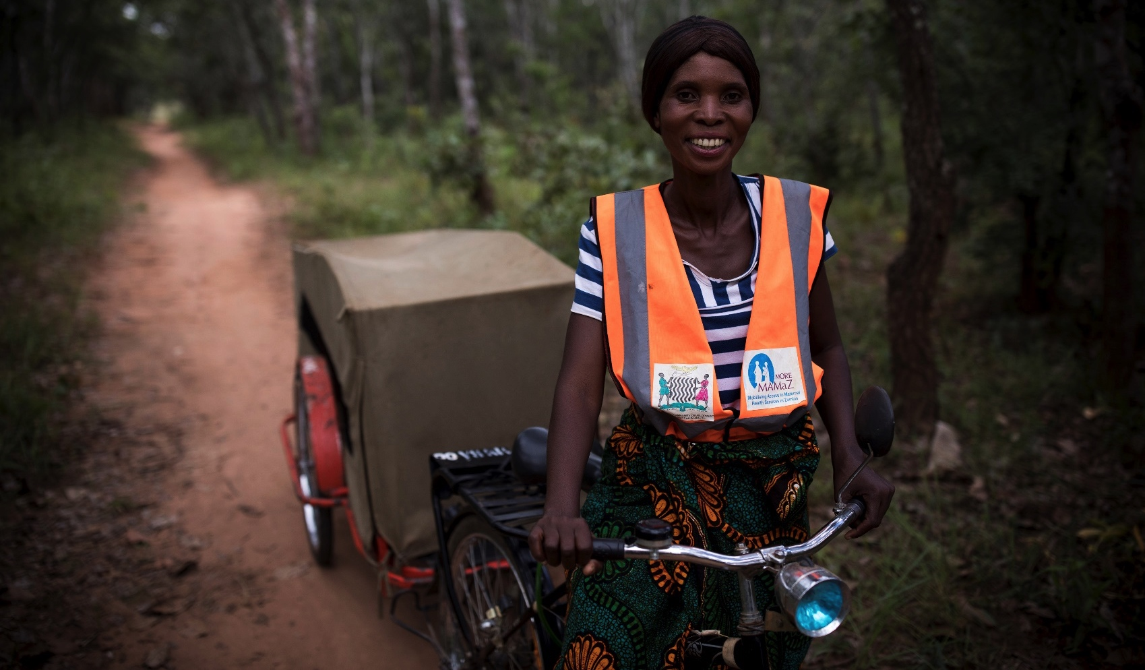
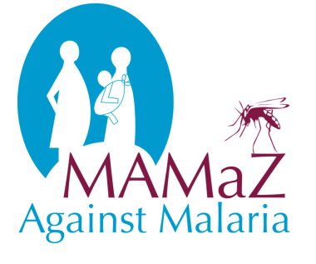

MAMaZ Against Malaria, Zambia
Project Approach and Results

Slide 2
Ernest Chanda, District Programme Co-ordinator, MAMaZ Against Malaria

Slide 3
Background
12-month pilot project (July 2017 – July 2018)
Implemented in Serenje District, Central Province
Focus is on severe malaria in children aged 6 months to 6 years
Pilot implemented by Transaid, Development Data, DAI Global Health and Disacare in partnership with Serenje DHMT and NMEC
Funding and technical support from Medicines for Malaria Venture

Slide 4
Global Context
WHO Guidelines have recommended use of rectal artesunate (RAS) as a pre-referral intervention for severe malaria in children aged 6 months to 6 years for the last 10 years
Timing was right to pilot this intervention in Zambia
RAS is part of Zambia’s strategy to eliminate malaria
Injectable Artesunate recommended by WHO as a treatment for SM at a referral facility, but many hard-to-reach communities struggle to reach a HF in a timely way
100mg pre-qualified RAS is a complementary intervention – supporting those patients who don’t have immediate access to life saving treatment for SM

Slide 5
Intervention
MAMaZ Against Malaria (MAM) tested:
      The feasibility of training CHVs to provide rectal artesunate (RAS). RAS is a pre-referral intervention for severe malaria given at community level
  Effective ways to mobilise communities to access appropriate treatment for severe malaria & reduce life-threatening delays
  How to build sustainable capacity at district level to support effective severe malaria case management (i.e. RAS at community level; injectable artesunate at rural HFs)
  How to prepare the ground for scale-up beyond the pilot intervention sites working in partnership with DHMT and NMEC
MAM set out to provide proof of concept and evidence of impact

Slide 6
Baseline
RAS not available in Zambian public health facilities
Very few HWs trained in use of injectable artesunate & this drug not used below district hospital level
HWs required refresher training in severe malaria case management
Low awareness at community level of severe malaria symptoms and severity, leading to delays in accessing appropriate treatment
Many other household and community barriers & delays to service use
Poor and incomplete knowledge of severe malaria danger signs among trained CHVs
8% of recorded cases of severe febrile illness resulted in death
Severe malaria cases under-reported in HMIS
Notes:
Baseline studies included:
Statistical baseline study
Facility audit
Rapid qualitative assessment at community level of knowledge, attitudes and practices

Slide 7
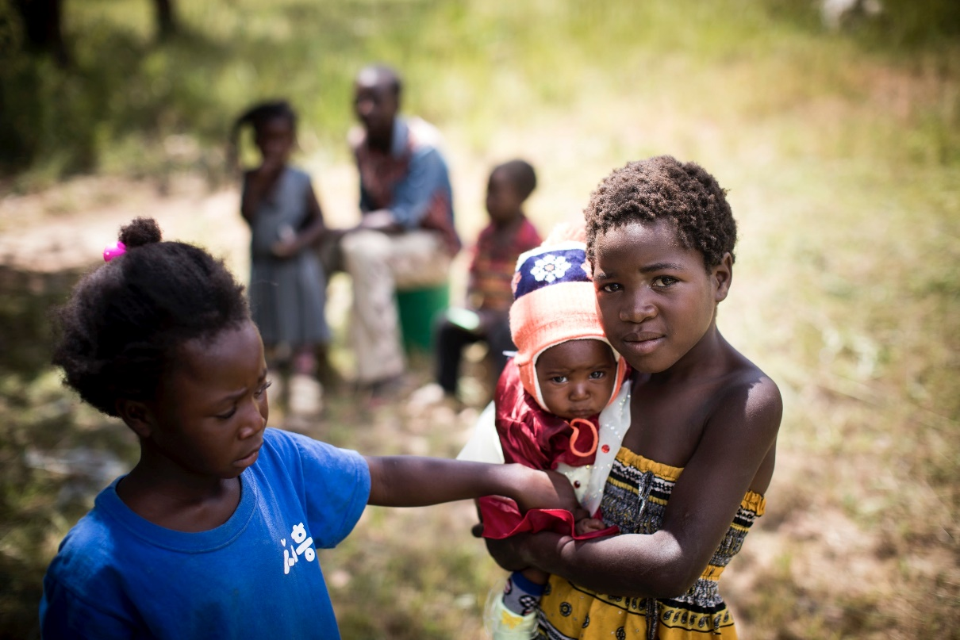
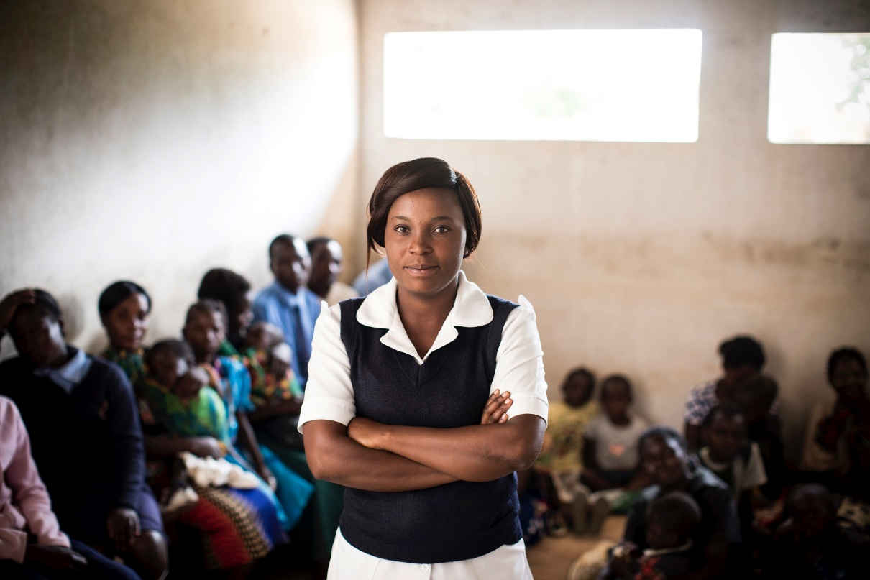
Intervention Sites
Health Facilities | Communities
8 | 45
33% of operational HFs in district | Target population 54,000, equivalent to 40% of district population

Slide 8
Intervention
Community Level
MAM built on two earlier projects, MAMaZ & MORE MAMaZ:
CHVs were trained to mobilise communities on severe malaria & child health
Community systems established to reduce access/affordability barriers and delays (e.g. food banks, emergency savings schemes)
Community-based emergency transport system aimed to strengthen referral
Community monitoring system, managed by CHVs, measured progress
Health Facility Level
Health providers trained in effective severe malaria case management, including use of injectable artesunate
Linkages between health facilities and communities strengthened via provision of mentoring and supportive supervision & data review
District, Provincial, National Level
Emphasis on building sustainable capacity for RAS programming at district level
      Sharing experience and results with provincial and national level (NMEC) to inform national scale-up

Slide 9
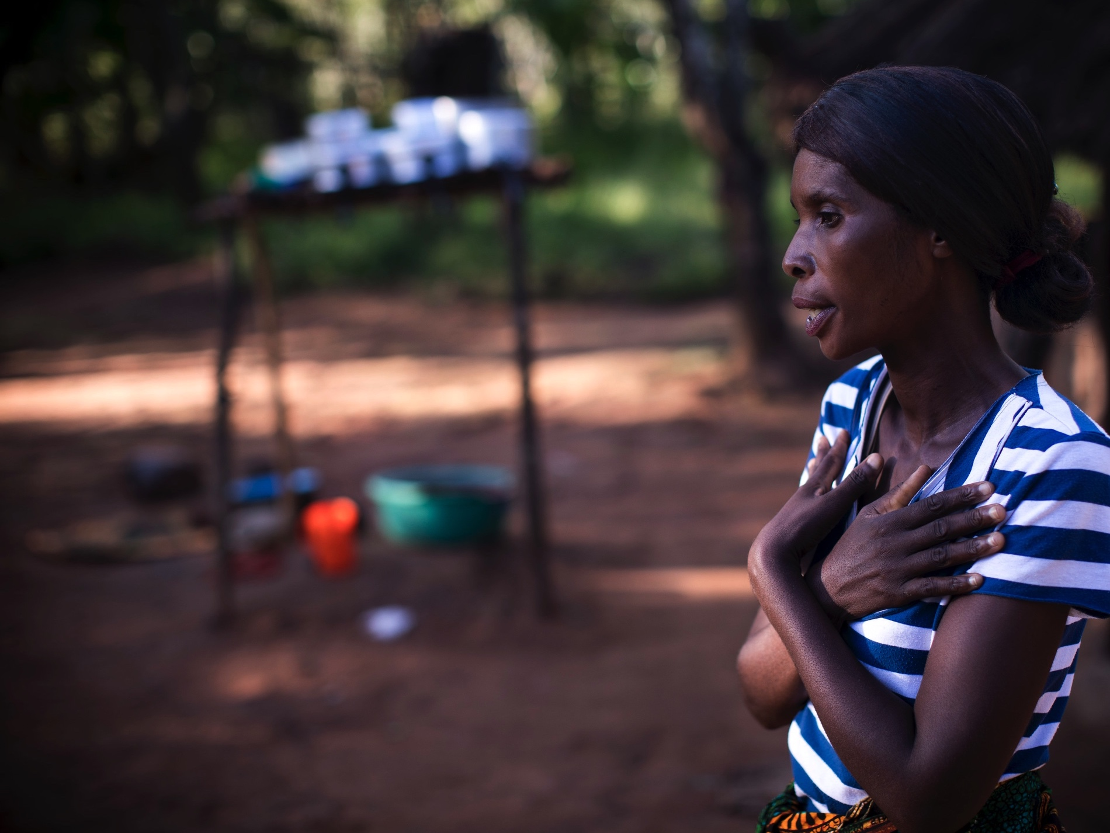
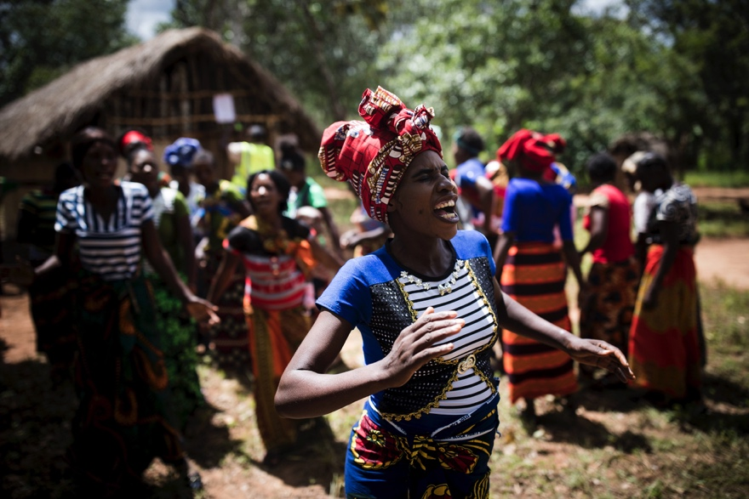
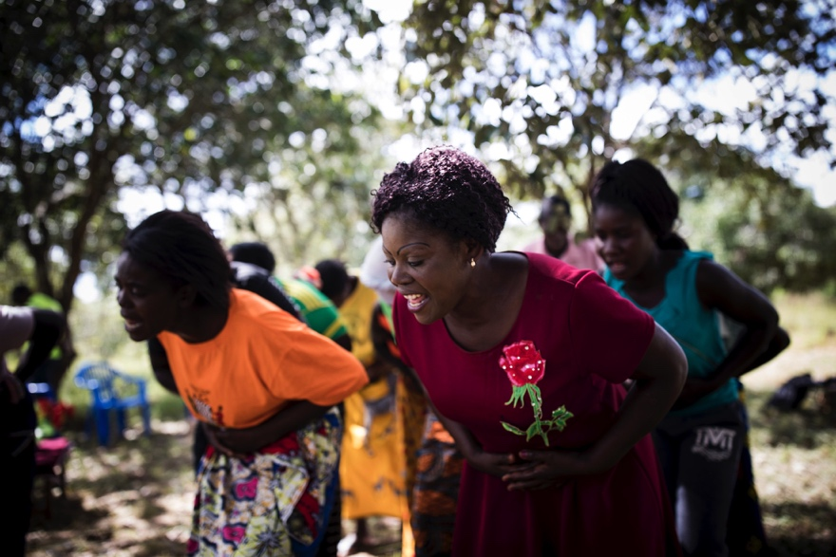
Community Engagement
Notes:
At this point ask the CHVs to talk for 3 minutes (i.e. very short) on:
Their training – what were they trained to do
How they mobilize the community
What the community systems are and their role (e.g. food banks, emergency savings schemes)
How they support the least-supported women and children in the community
Ask them to end their short presentation by demonstrating the SM danger signs
No emphasis on results at this stage

Slide 10
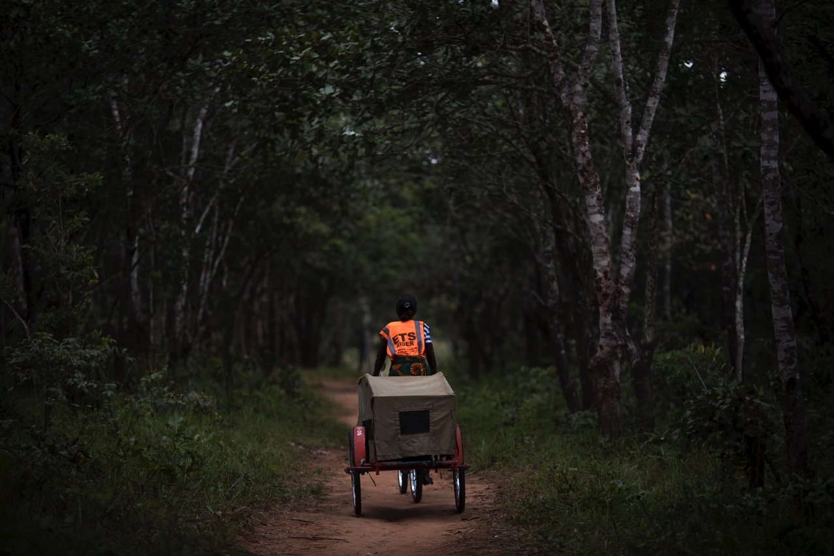
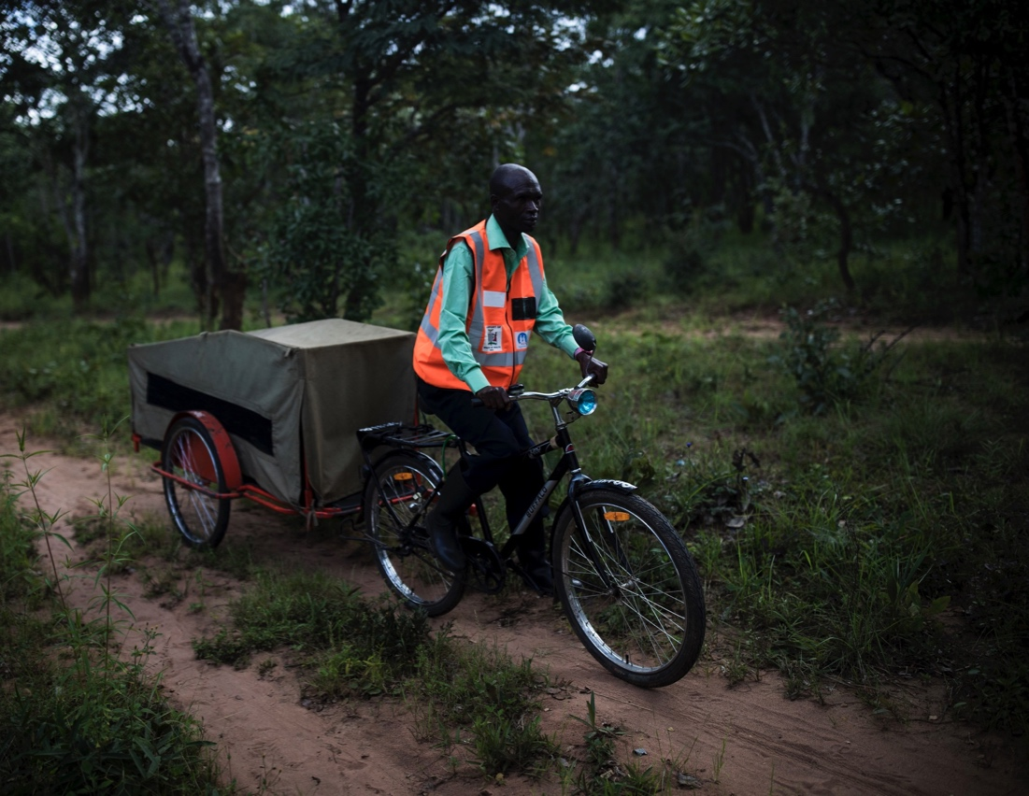
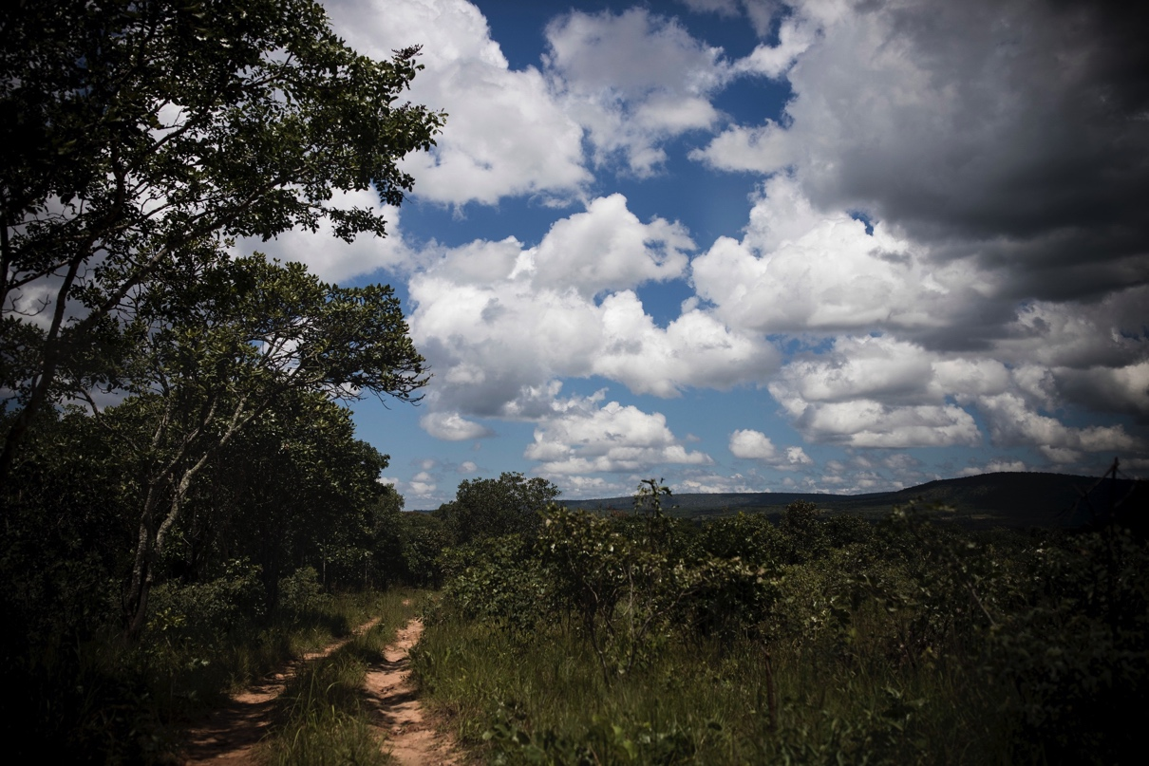
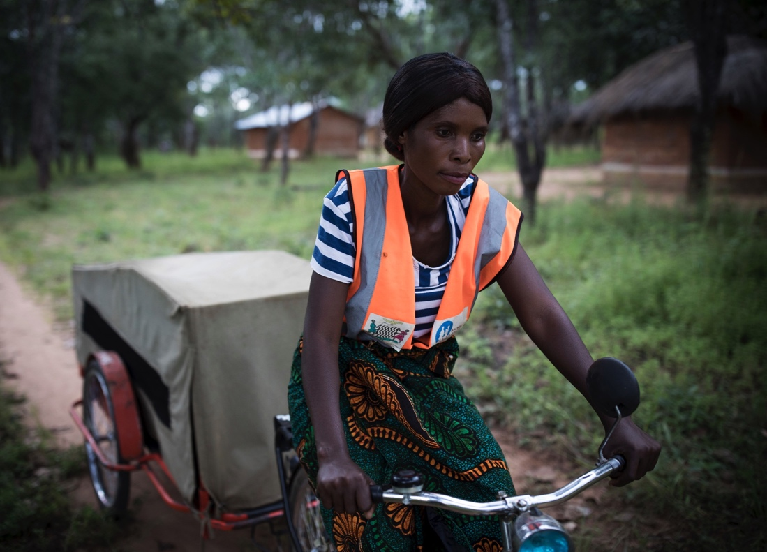
Community ETS
Notes:
At this point ask a ETS rider to talk for 3 minutes on what they do (no emphasis on results at this stage)
What is their role?
How do they work together with CHVs?
How do they interact with, and how are they supported by the HF?
How is the BA stored and maintained?
How do they keep records and report on progress?

Slide 11
Dr Haachile Moonga, District Health Director, Serenje

Slide 12
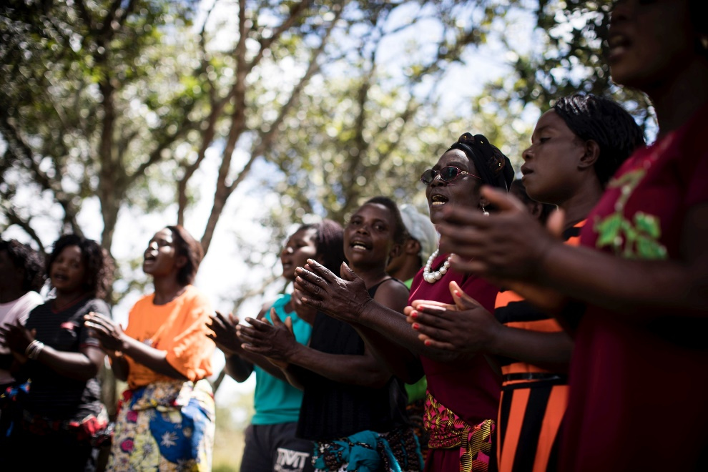
Achievements
RAS was successfully procured for use in Serenje District
Pool of district master trainers in community RAS trained, creating lasting capacity within the district
477 CHVs trained in community mobilisation for severe malaria & other common childhood illnesses; of these, 225 CHVs trained to administer RAS
CHVs with RAS training also given training in RDTs in line with national policy
78% of intervention communities without alternative transport options supported to operate Emergency Transport Systems (ETS); 66 ETS riders trained
HWs in all 8 intervention facilities were
  trained in effective severe malaria case
  management; injectable artesunate is now
  available in all intervention HFs, and in other
  HFs across the district
Strong partnership between MAM & DHMT;
  MAM’s emphasis was on supporting
  and facilitating a district-led severe malaria
  intervention

Slide 13
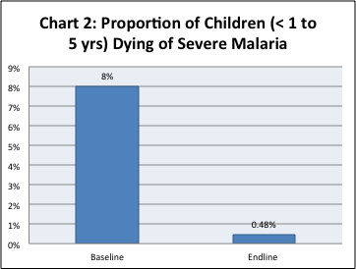
Results
Severe Malaria Case Fatality
Source: HMIS
SM case fatality rate fell from 8% at baseline <0.5% at end line
This is equivalent to >95% reduction in the SM case fatality rate
Notes:
Data covers November 2017 – end Jan 2018.

Slide 14
Results
Malaria Incidence
Timeframe | Malaria cases (adults and children) | Malaria cases (children < 1) | Malaria cases (children 1-5 years) | Total (children < 1 to 5 years) | Severe malaria cases (children < 1 ) | Severe malaria cases (children 1-5 years) | Total
Baseline Nov 16-Mar 17 | 17,529 | 1,434 | 6,166 | 7,600 | 34 | 156 | 190
End line Nov 17-Mar 18 | 14,686 | 1,615 | 4,911 | 6,526 | 189 | 430 | 619
Net change | -2,843 | 217 | -1,255 | -1,074 | 155 | 274 | 429
Source: HMIS records
Total malaria cases (adults & children) fell 16% between baseline & end line
Malaria cases in children < 1y/o increased by 12%, most likely indicating better reporting in this age group
Reported cases of severe malaria increased from 34 to 189 for children under age of 1 (p<0.05), and from 156 to 430 among those age 1-5 years (p<0.05), most likely indicating better identification of these cases
Notes:
Showing an increase in SM reporting and a reduction in death
Indoor residual spraying (IRS) was carried out in Jan/Feb 2018 and distribution of ITNs happened in November 2017.
IRS was also carried out the previous year (do we know when?)
These interventions are likely to have made a difference to the malaria prevalence rate.

Slide 15
Results
RAS Beneficiaries (project monitoring data)
After 7 months of implementation, 1,215 children with suspected severe malaria had received RAS
100% (1,215/ 1,215) of suspected SM cases identified in the community were given RAS and referred to the HF
Notes:
Notes:
This result – 1,215 beneficiaries – is based on the CMS.

Slide 16
Results
Referral and Follow-Up
Indicator | Progress by EOP
Children who received RAS in community and were referred to a HF providing SM treatment | 100%
RAS beneficiaries who were referred to a HF and received a counter referral form | 72%
Children given RAS by CHV who were followed up for adverse events in 30 days post-exposure | 100%
Children with suspected severe malaria transported to HF by ETS | 71%
Source: Community Monitoring System
100% of RAS beneficiaries were referred to the HF by CHVs
100% of children given RAS were followed-up by CHVs, with multiple follow-up visits in some cases
ETS supported 71% of all SM cases
RAS verification exercise confirmed that children with SM were treated with Inj AS at facilities
Notes:
RAS verification exercise confirmed that children with SM were treated with Inj AS at facilities
Notes
Many of the project targets were reached / exceeded
The data on follow-up doesn’t give a clear picture of what happened in the intervention communities. However, in the end line survey 92.4% of CHVs said that they followed up RAS cases upon their return from the HF.

Slide 17
Results
Malaria and Severe Malaria Case Management
Indicator | Baseline | End line
Last managed a case of malaria / SM this year | 66% | 97%
Children w suspected malaria who were referred to HF | 66% | 99%
CHVs who said they were confident to administer RAS | n/a | 98%
CHVs who had referred a case of suspected SM to the HF | n/a | 93%
CHVs who used a referral form when referring a suspected SM case to the HF |  | 99%
CHVs who had last managed a case of malaria / SM this year increased from 66% (baseline) to 97% (end line), showing an increase in malaria-related activity
93% of CHVs trained by MAM referred a suspected SM case to the HF, showing that most CHVs applied their training
98% of CHVs said they were confident to administer RAS
Source: MAM End Line Survey
Notes:
Notes

Slide 18
Results
Severe Malaria Knowledge - CHVs
Indicator | Baseline | End line
Knows ‘fitting’ as SM danger sign | 52% | 88%
Knows ‘vomits everything’ as a SM danger sign | 52% | 91%
Knows ‘not able to eat or drink’ as a SM danger sign | 29% | 86%
Knows ‘unconscious and lethargic’ as a SM danger sign | 47% | 51%
For most danger signs, knowledge improved significantly
85% of CHVs knew 3 or more SM danger signs at end line compared to < 50% at baseline
Source: MAM End Line Survey
Notes:
Notes

Slide 19
Results
CHV Perceptions of Malaria Delays and Mortality
Indicator | End line
CHVs who think that child deaths from severe malaria have reduced since the start of MAM | 99%
CHVs who think that child deaths from severe malaria have reduced by a large amount since the start of MAM | 85%
CHVs who think that fewer children are being delayed in being taken to a HF when suspected of having malaria | 77%
CHVs who think that fewer families are relying on traditional medicines to treat suspected malaria | 92%
Source: MAM End Line Survey
Almost all CHVs (99%) thought that child mortality from SM had reduced over the lifetime of MAM; 85% by a large amount
77% of CHVs felt that delays in transferring children to the HF had reduced, and 92% that there was less reliance on traditional medicine
Notes:
Notes

Slide 20
Results
Sustaining CHV Activities
Indicator | CHVs | ETS Riders | Total
Intention to continue volunteering | 98% | 97% | 98%
Intention to continue volunteering ‘forever’ | 70% | 82% | 71%
Volunteers motivated by a ‘wish to help my community’ (i.e. altruism) | 95% | 100% | 96%
Source: MAM End Line Survey
Almost all CHVs (98%) said that they intended to continue volunteering beyond the end of MAM; 71% ‘forever’
96% of CHVs were motivated by altruism – a wish to help their community
Many of the volunteers had continued their volunteering activities since being trained by MAMaZ (2010-2013) or MORE MAMaZ (2014-2016), showing a high level of motivation
Notes:
Notes

Slide 21
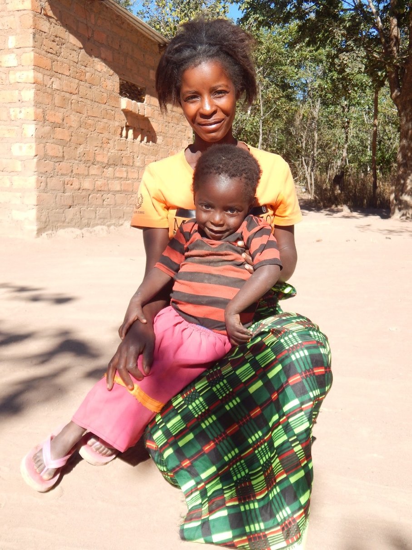
Case Study: RAS Beneficiary
On a Friday night in May 2018 Mervis Kunda age 3, showed signs of being unwell. The child had a high fever and had lost her appetite. Later on the next morning she started to convulse. Mervis was rushed to Idess Mwape a CHV trained by MAM.
Idess confirmed that the child had suspected severe malaria based on danger signs that she had observed. An RDT for malaria came out positive. Mervis was quickly administered RAS. While the child was being attended to, an ETS rider was called. Mervis and her mother were rushed to Mulilima Rural Health Centre in a bicycle ambulance. The journey took 1.5 hours. On arrival, the health workers checked the child and confirmed severe malaria.
Mervis was put on Injectable Artesunate and received her first dose around 09hrs. She was admitted for observation and treatment. A second dose was given around 20 hours and the child responded positively. She started to get interested in her surroundings and also to eat. Mervis was discharged the following morning, having received her last dose of Injectable Artesunate. Her mother was given Coartem and Panadol to complete Mervis' malaria treatment.
When the family were visited in June 2018, Mervis had fully recovered. Priscilla thanked MAM and the Ministry of Health for saving the lives of many children. She remarked that before the project came to her community, many children died from severe malaria. The situation had now changed.

Slide 22
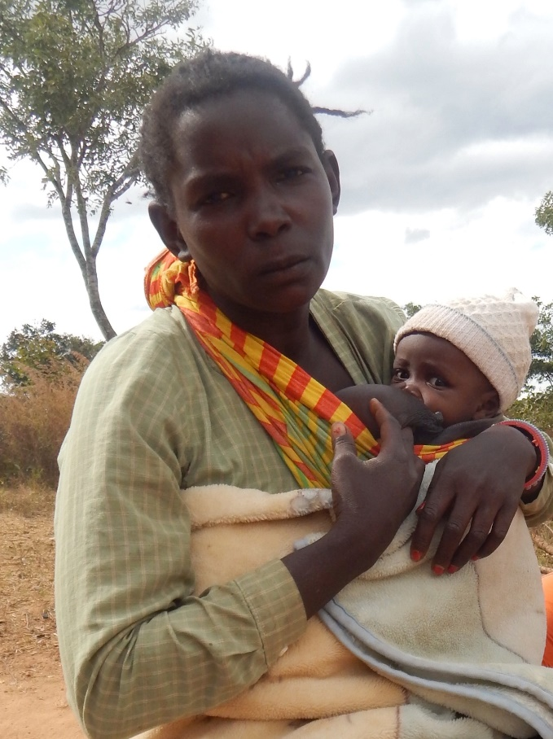
Case Study: Supporting the Least Supported
Barbra Bwale and her family live in the catchment area of Kalela Rural Health Post in Serenje. Both she and her husband suffer from mental health issues. They currently have 7 children, but several of their children have died in the past. Until a year ago, Barbra had never visited a health facility or been supported by a CHV. Her extended family found it difficult to support her because they live a long way away. CHVs were informed of Barbra’s predicament and she was put on a list of community members needing frequent support. Following a first visit by a CHV, Barbra attended an ante-natal care session at the health facility. She was invited to severe malaria discussion sessions when they started in her community. Sometime later Barbra gave birth to a baby girl.
Barbra said:
“The CHVs have taught me a lot. They visited me when I was pregnant. I have received good education from them, financial support from the community savings scheme, food from the community and my family now comes to help me…. When I was due to deliver volunteers organised a bicycle ambulance to take me to the clinic…..The CHVs are still visiting me regularly and I have learnt severe malaria signs like fever, vomiting all, failure to feed….I now go to the under-fives clinic, and community meetings. We have even joined the agricultural co-operative programme to benefit from farming inputs. The CHVs are good people. You can see that my child is in good health.”
Notes:
Notes
This case study is one of many such changes where socially excluded members of the intervention communities have been included in project activities.
The project has worked hard to ensure awareness among the wider community of social exclusion – and the link with poor health access and outcomes.
It is true to say that there is now greater understanding of these issues and a willingness to support the least-supported.
MAM’s emphasis on social inclusion is very much in line with the Government’s commitment to Leaving No-one Behind.

Slide 23
Conclusion
MAM increased the availability of RAS and injectable artesunate for treatment of children with suspected severe malaria in Serenje District
A large number of children with suspected severe malaria were appropriately managed with RAS at community level and effectively referred
The severe malaria case fatality rate among children aged < 1 to 5 years reduced significantly – from 8% to <0.5%, showing that it is possible to eliminate malaria
Intervention communities readily embraced the need for early identification and referral of severe malaria cases
MAM’s emphasis on social inclusion helped ensure that no-one was left behind. This is crucial – the least-supported often have the poorest access to services and carry the highest burden of ill-health
An effective partnership between MAM, Serenje’s DHMT and NMEC was central to the results achieved
The Serenje pilot demonstrated proof of concept – that RAS can be effectively administered at community level by trained CHVs, with access to emergency transport system – and generated robust evidence of impact
The pilot therefore paves the way for and provides a strong rationale for wider national scale-up

