Slide 1
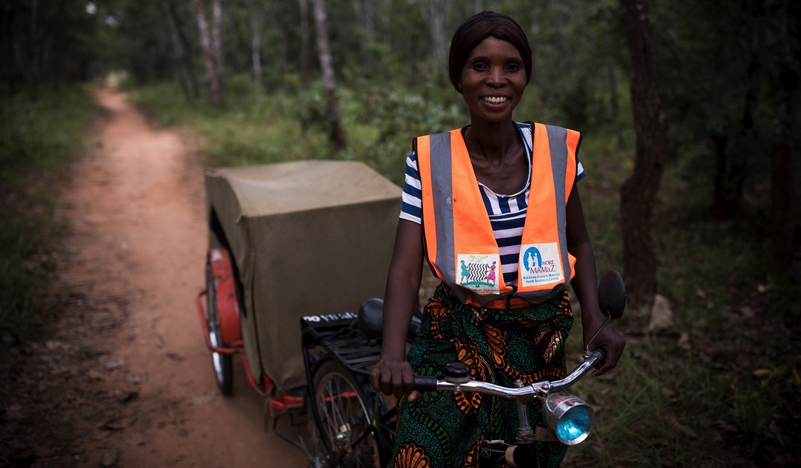
MAMaZ Against Malaria, Zambia
Emergency Transport Systems

Slide 2
Victor Simfukwe, ETS Manager, MAMaZ Against Malaria
Bernard Mpande, ETS Support Officer, MAMaZ Against Malaria

Slide 3
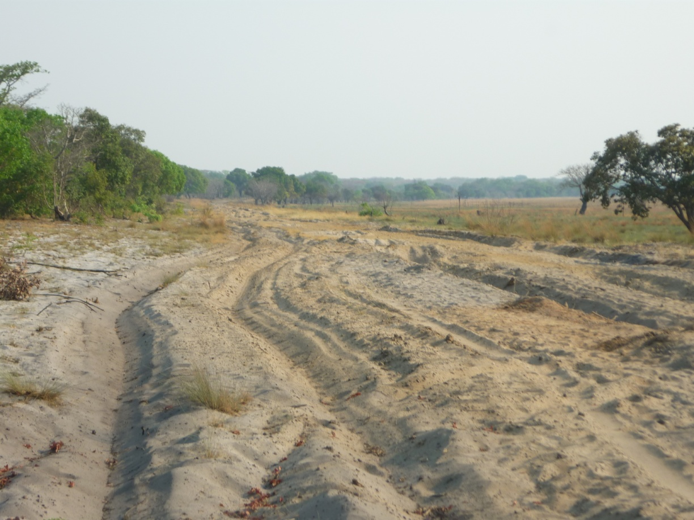
Background
Physical barriers to accessing health facilities
In rural Zambia, transport availability is often:
Expensive - cost can be a major barrier to use
Limited in availability
Terrain can be challenging
Currently many people walk to reach facilities
Sometimes people are discouraged from travelling at all due to lack of transport
With suspected severe malaria timely
access to health services can be a matter
of life and death
Delays can worsen clinical severity of cases
Notes:
Link last point to the ‘referral gap’

Slide 4
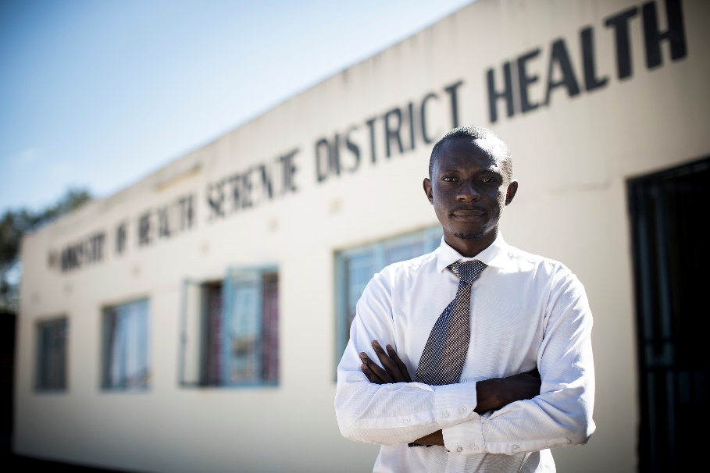
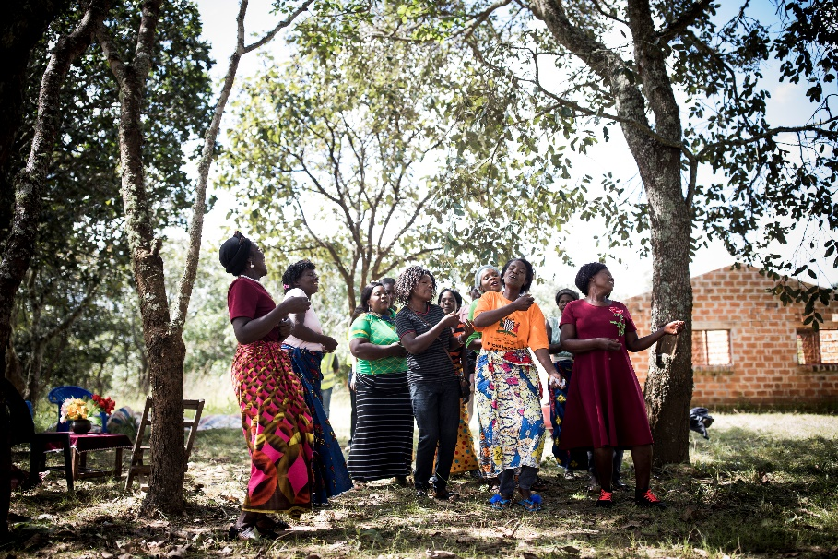
Strategy
Approach
Close collaboration with District Health Management Teams (DHMTs)
Comprehensive design work at the community level looked at:
- distance
- terrain
- socio-cultural & economic context
- local transport culture
- accessibility of spare parts
Findings informed the ETS design and ensured the programme built on what was already in place

Slide 5
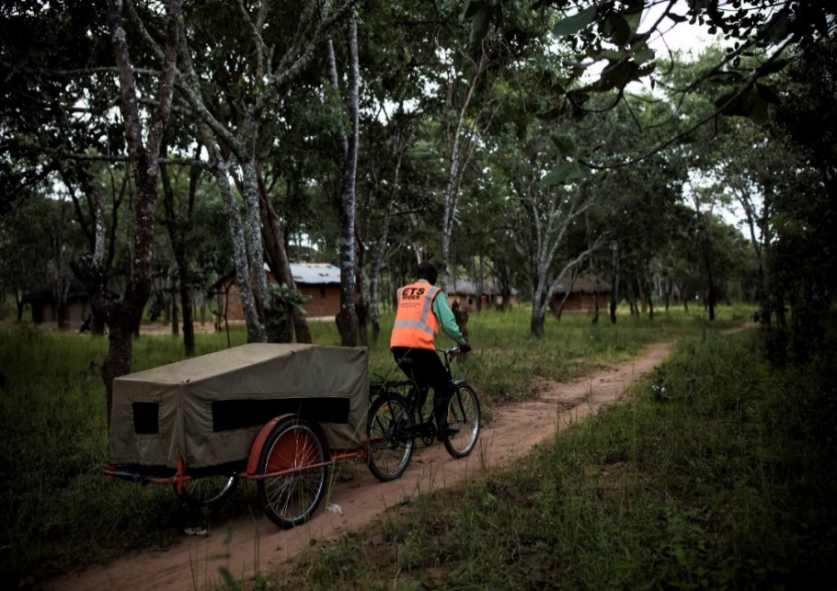
Bicycle Ambulances
BA trailer and stretcher system was produced by Disacare, a Zambian NGO (bicycles supplied through World Bicycle Relief)
16 new BAs added to existing fleet of 23
Stretcher can be detached from the frame
BAs include a full canopy for protection and privacy
Increased height on canopy so child and adult can travel together
Good ground clearance
Bicycles and trailer are robust and durable
Each BA was supplied with essential ‘tools of the trade’ – logbooks, rain suits, lights, and some basic tools

Slide 6
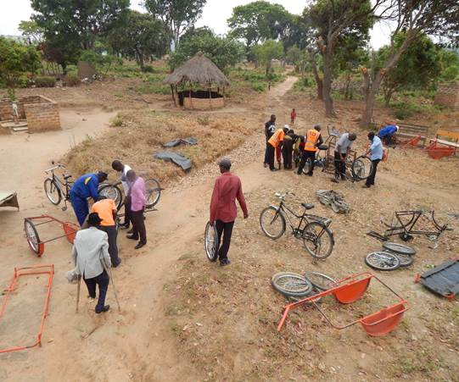
Mobilising and Training Riders
ETS Riders and custodians of vehicles nominated by the community
Wider community engaged in discussions on how to access the vehicles
Community entirely responsible for maintenance, safe-keeping and responsible usage
DHMT was involved in all aspects of the ETS, from the initial needs assessment work, to on-going monitoring, and review activities
66 ETS riders trained (2 per ETS)
Training included:
Role of an ETS volunteer
Basic ETS maintenance
Handling referral forms
Recording trips in logbooks

Slide 7
ETS Rider experiences

Slide 8
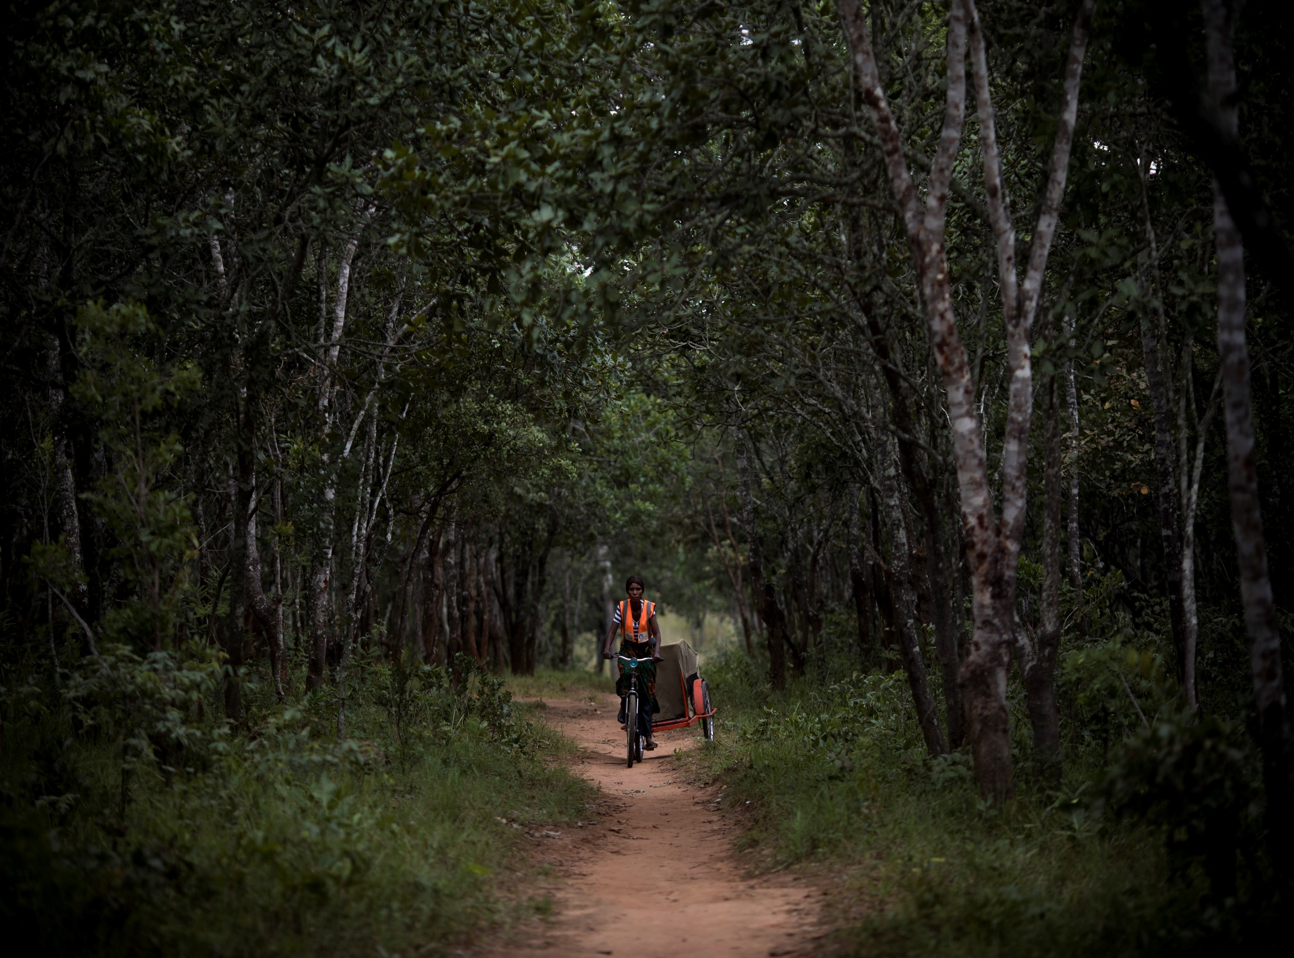

Slide 9
Results
Communities can now access transport in an emergency
Travelling by bicycle ambulance is quicker than walking
Lying in a trailer is safer than sitting on the parcel carrier
Feedback from communities and DHMT suggests that ETS is highly valued despite being non motorised
ETS riders have increased social status in their communities
The community-managed approach helped to strengthen community cohesion.

Slide 10
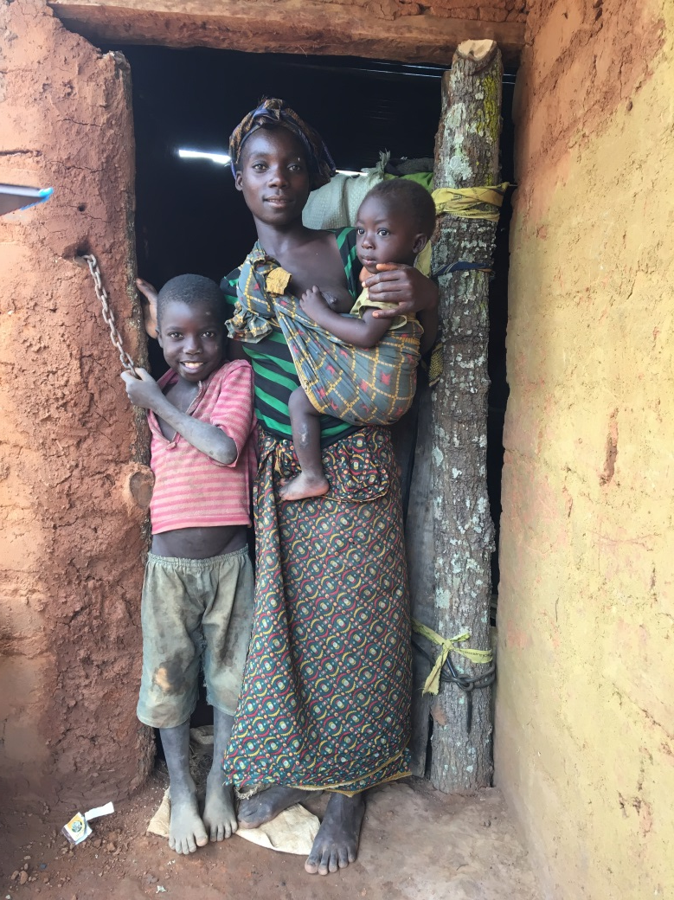
Results
Headlines
71% of suspected severe malaria cases were supported by ETS in areas with bicycle ambulances
Each ETS rider had transported an average of 10 clients since the time they were trained
Communities were able to rely on ETS 24/7’
Average distance was 14km one way

Slide 11
Value for Money
MAM made the initial capital investment:
Bicycle ambulance (trailer + bicycle)
Ongoing running costs are low compared to motorised transport (savings schemes can help)
The cost of community-based ETS training is modest
The riders work as volunteers
The cost per trip goes down over time and the assets offer their communities value for money
Unit costs:
BA K7,600 / £543
Estimated total unit costs per ETS rider (training, kit and supervision) = GBP 78.50
Estimated total cost for one community to have ETS (2 x trained, equipped and supervised riders, 1 bicycle ambulance and accompanying bicycle) = GBP 843

Slide 12
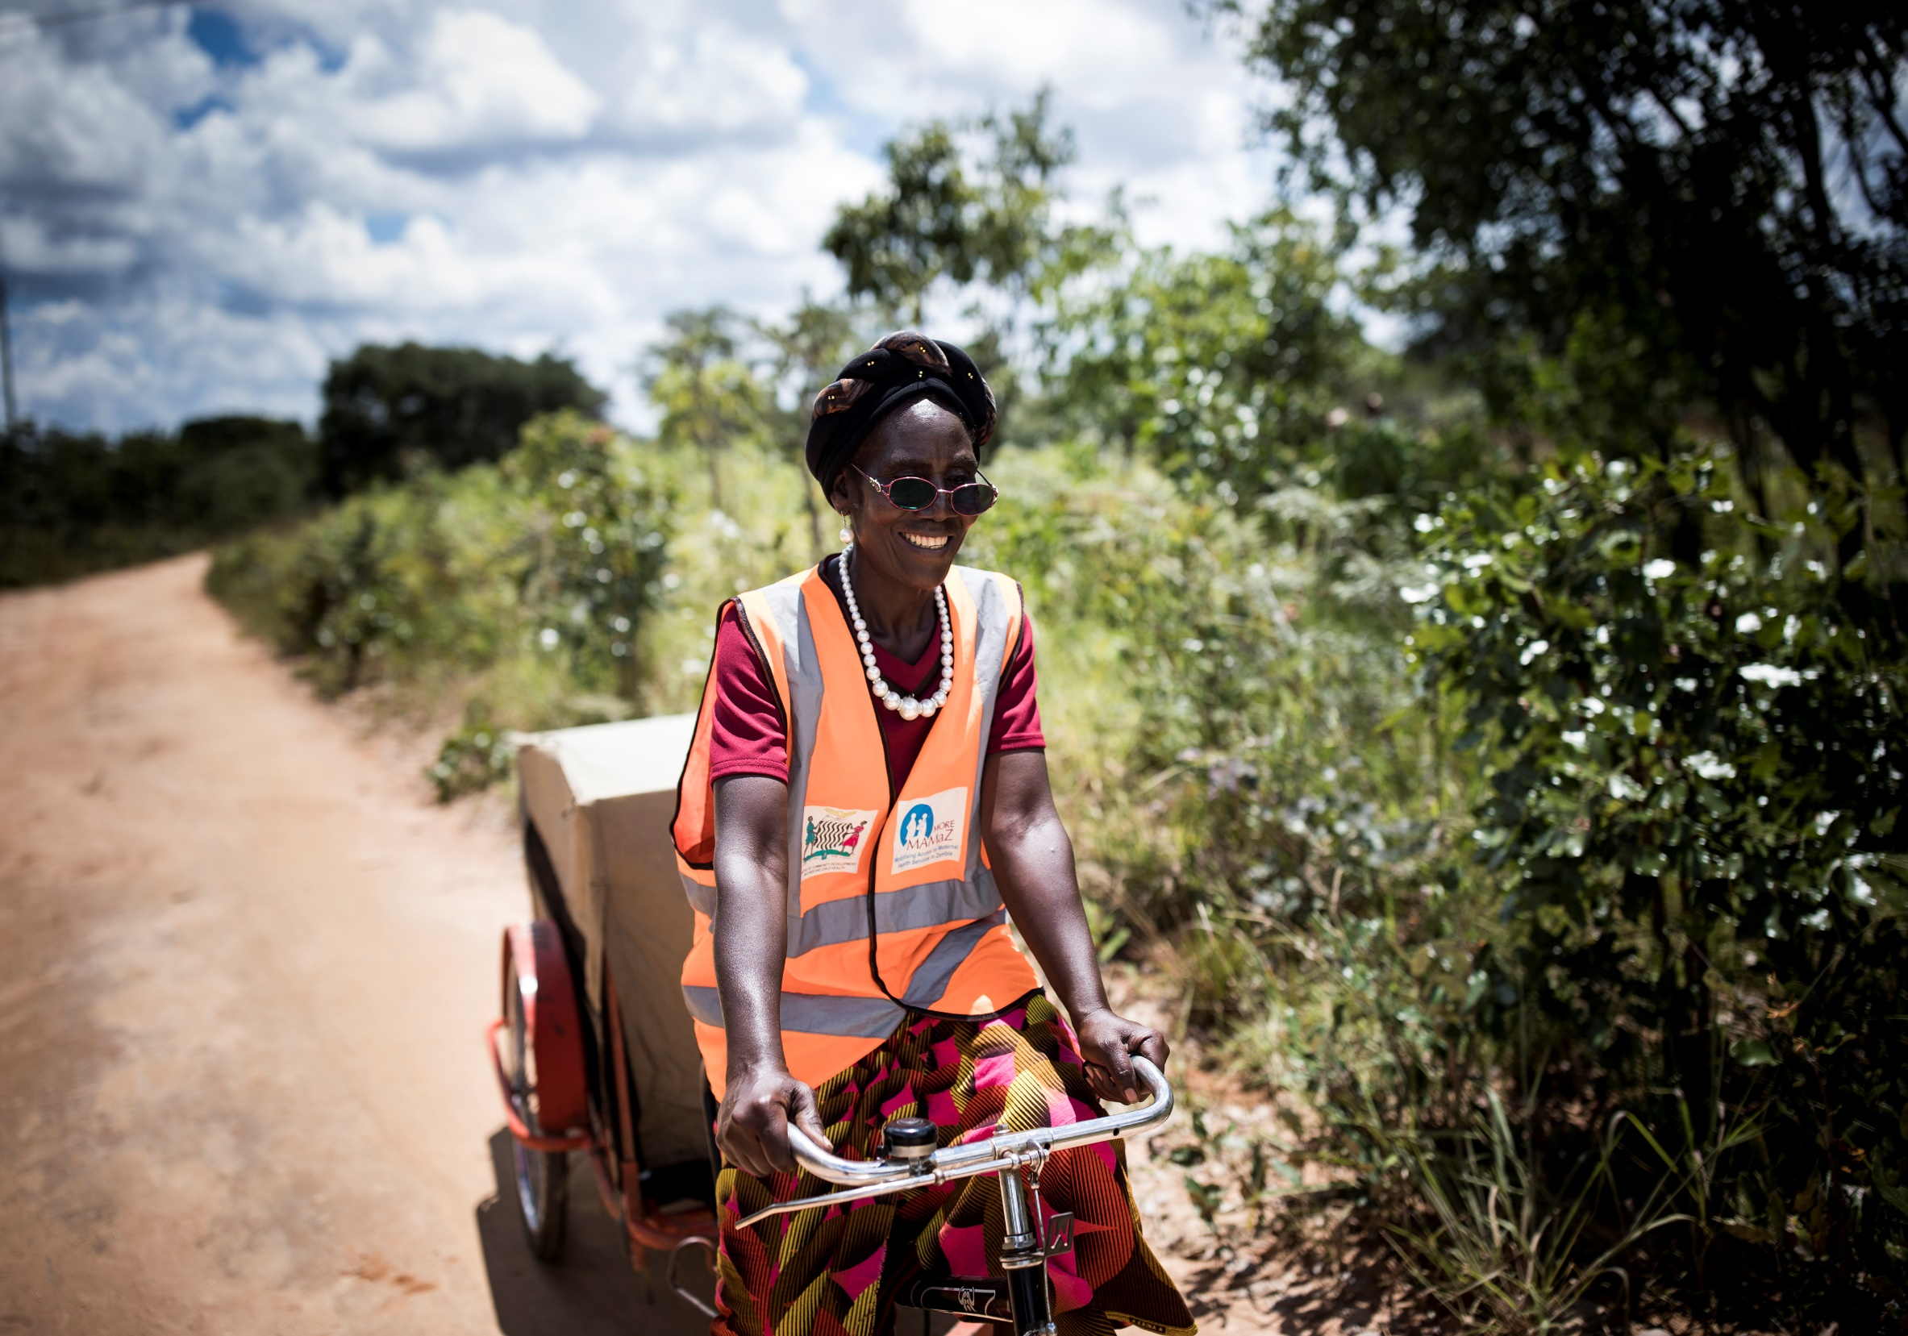
“The bicycle ambulance is the best thing that has happened to this community. I see people going about their daily lives in my community who otherwise wouldn’t be alive today.”
Josephine Mupeta
ETS Rider Serenje
"

Slide 13
Lessons Learned
ETS needs to be suitable for the terrain, culturally appropriate and easy/affordable to maintain
Ensure that spare parts are readily available
Link to saving schemes or income generating activities help finance ETS repairs
An ETS audit system that provides real time information to DHMTs about the state of ETS vehicles can be useful
If the community management system is weak the chance of failure is high
ETS riders can still improve on knowledge of SM danger signs
ETS works best when implemented as part of a broader community engagement and empowerment effort that addresses all demand-side barriers to use of MNH services simultaneously

Slide 14
Policy Recommendations
Our key messages
Introducing RAS at the community level and ensuring there is a transport system in place has resulted in many more children with suspected SM reaching facilities
The referral gap between communities and the facility needs to be acknowledged and addressed in health policy and strategy
Replacement costs for ETS vehicles should to be considered in national or district health budgets
A focal point is needed within the MOH and in DHMTs for all activities that help strengthen the community health system, including community-based emergency transport systems
To avoid procurement of inappropriate ETS vehicles, government departments and development partners should use locally appropriate and evidence-based ETS solutions

